Slide 1
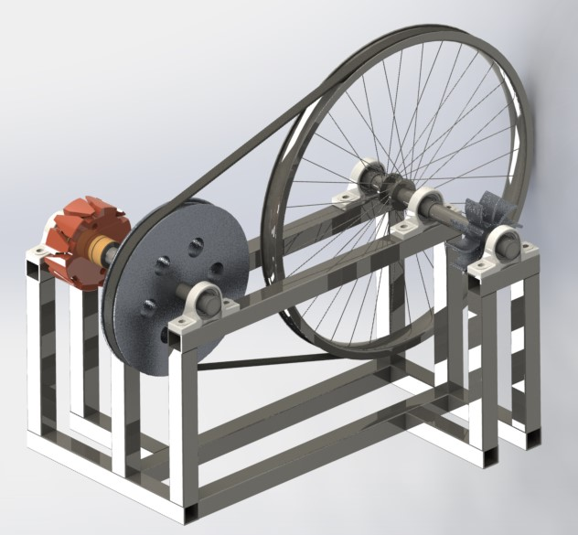
Semester Project: Flat Belt Pulley Hydroelectric Generator
By: David Kmieciak, Derek hartmon,
Abdullah turkistani, & Mitch weisser

Slide 2
The Mechanical Advantage
Decided between gears, screws, pulleys, bar mechanisms, and levers.
  Gears:
  Hard to find two with same teeth geometry/pitch.
  Aluminum sand casting wouldn’t work
  Screws:
  Not very applicable for this specific project.
  Not likely to be found in junk yard.
  Bar Mechanism:
  Only produce a slight mechanical advantage.
  Hard to setup.
  Lever:
  Not very useful for high RPM situations.
  Used more for lifting heavy objects with a small amount of force.
  Pulley:
  Good for high RPM situations.
  Could be aluminum sand casted.

Slide 3
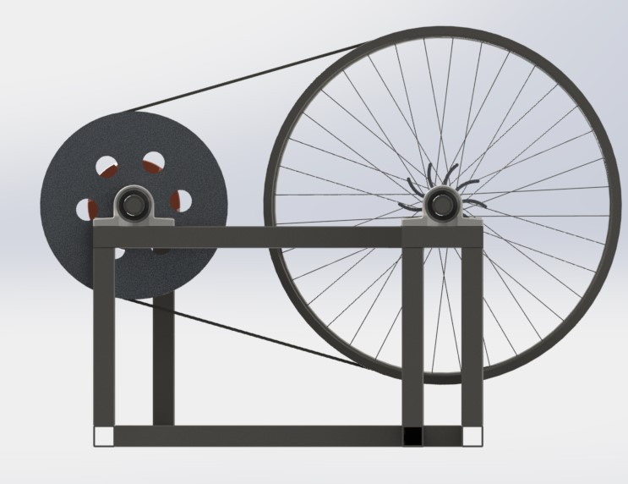
Our Mechanical Advantage:
The Flat Belt Pulley System
Gear Ratio: 2:1
Keep as much surface area as possible.
Robert Juvinall and Kurt Marshek say, “The capacity of a belt to drive is normally limited by the slippage of the smaller pulley” (787).
Does not NEED to be exactly 2:1.
Belt Type: Flat.
Flat belts are better than V-belts in high speed applications.

Slide 4

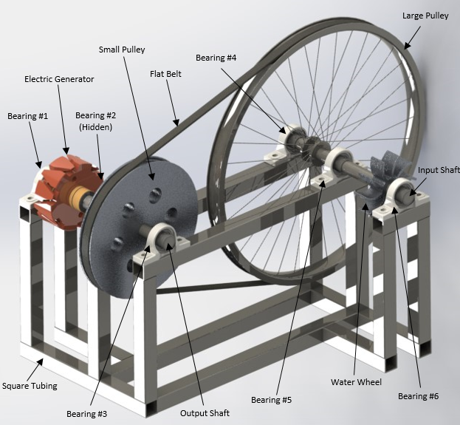



The Complete Mechanism
The system includes:
Large Pulley.
Small Pulley.
Input & Output Shaft.
Bearings.
Square tubing.
Electric Generator.
Water Wheel.

Slide 5

Breaking It Down
Big Pulley: We picked a bicycle rim because it we figured it would be easy to find in a salvage yard or in the neighborhood.
Small Pulley: This part would be aluminum sand casted so the exact diameter and geometry could be determined to match the desired 2:1 gear ratio.
Bearings: Allows the whole mechanism to have great shaft rotation and tolerance.
Square Tubing: Great for strong structural support.
Water Wheel: Easiest to just aluminum sand cast rather than try to find.
Electric Generator: Either made by Hastings or try to find a pre-built generator.
Flat Belt: Find in any average mechanical car system or pulley mechanism.
Input & Output Shafts: Any diameter at least 10mm or bigger.
www.clipground.com

Slide 6
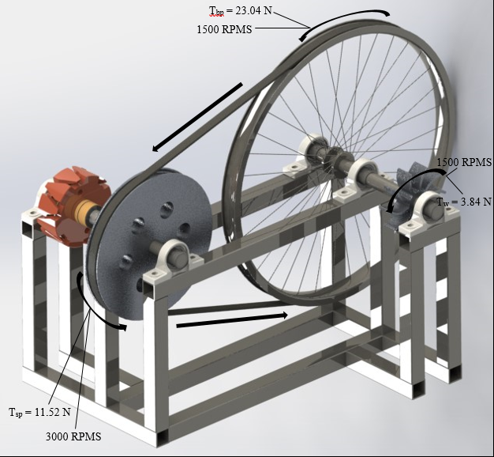
The Calculations: Part 1
Determined torques applied to the whole mechanical system.
=
=

Slide 7
The Calculations: Part 2
The next set of calculations was used to determine the safety factor of the input shaft.

Slide 8
The Calculations: Part 2 (Cont.)

Slide 9
The Calculations: Part 2 (Cont.)
Safety Factor of Input Shaft = 140

Slide 10
The Calculations: Part 3

Slide 11
The Calculations: Part 3 (Cont.)

Slide 12
The Calculations: Part 3 (Cont.)
The Safety Factor for the Output Shaft = 80

Slide 13

Overview Summary
We believe a pulley would be his best choice considering his current options.
Tried to keep a balance between smooth and efficient without going too complex.
Torque and stress analysis’s determined no failure.
Didn’t want to design a product, but rather design an operation that would produce him the most power possible.
www.studentpilotnews.com

Slide 14
Work Cited
Juvinall, Robert C., and Kurt M. Marshek. Fundamentals of Machine Component Design. 5th ed. New York: Wiley, 2000. Print.
Nikhil, Nandepu. "Bicycle Rim." GrabCAD. Stratasys, 12 Oct. 2016. Web. 18 Apr. 2017.
"Mounted Ball Bearings." McMaster-Carr. McMaster-Carr, n.d. Web. 15 Apr. 2017.

Slide 15

Questions?
www.clipartfest.com

